Slide 1
PEOPLE’S DEMOCRATIC REPUBLIC OF ALGERIA
MINISTRY OF HIGHER EDUCATION AND SCIENTIFIC RESEARCH
MOHAMED-CHERIF MESSAADIA UNIVERSITY
FACULTY OF LETTERS AND LANGUAGES
DEPARTMENT OF ENGLISH
Group: First year LMD
Course One:
What is Linguistics?
Teacher: Dr. Nacereddine Benabdallah
Academic Year: 2023-2024

Slide 2
7,168
languages in the world

Slide 3


What is the most spoken language?
Mandarin Chinese English
Most native speakers Most native speakers
920,000,000 373,000,000
Other speakers
1,080,000,000

Slide 4
Country | Languages
Papua New Guinea | 840
Indonesia | 715
Nigeria | 527
India | 456
United States | 337
Australia | 317
China | 307
Mexico | 301
Cameroon | 277
Brazil | 238

Slide 5
ALGERIA
14 living languages
1/Algerian Spoken Arabic 10/ Tahaggart Tamahaq (Ahaggar Mountains)
2/Algerian Sign Language 11/ Taznatit (Gourara, Adrar)
3/ Algerian Saharan Spoken Arabic 12/ Temacine Tamazight (Touggourt)
4/ Amazigh 13/ Tidikelt Tamazight (Tamanrasset)
5/ Chenoua (Tipaza, Cherchel…) 14/ Tumzabt (Ghardaia)
6/ Hassaniyya Arabic (Tindouf)
7/ Korandje (Tabelbala)
8/ Tachawit (Awras Moutains)
9/ Tagargrent (Ouergla)
Standard Arabic: official language of the country
French is used in education and media
English, Itlaian, German, Spanish and Russian are used in education

Slide 6
Which language has the largest alphabet?
Khmer (cambodian) language: 74 letters
Which language has the shortest alphabet?
Rotokas (Island of Bougainville, east if New Guinea) 12 letters
Which language has the largest number of sounds?
Taa language (Botswana and Namibia): 87 consonants, 20 vowels (107 sounds)
Which language has the shortest number of sounds?
Rotokas : 11 sounds

Slide 7
English has
26 letters : 21 consonants and 5 vowels.
44 sounds: 24 consonant sounds and 12 vowel sounds (7 short and 5 long) + 8 diphtongs.
20% of the world speaks English (1, 35 billion) with 373 million native speakers.

Slide 8
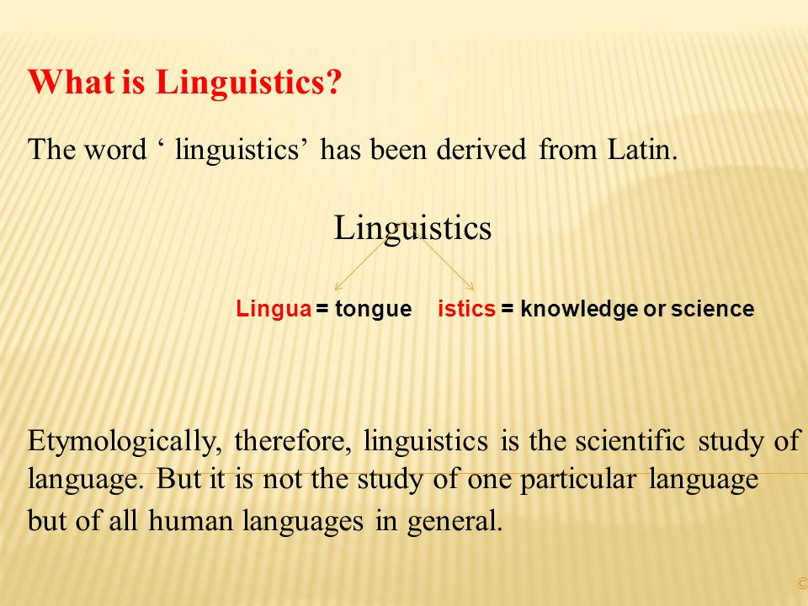

Slide 9
The scientificity of linguistics is based on the following canons of the scientific method:
Exhaustiveness (analyses all facts of language)
Consistency (logical study, no contradictions)
Economy (no repetition, economic statements are preferred to longer ones)
Objectivity (free form misconceptions and prejudices about particular languages)

Slide 10
Linguistics vs Traditional Grammar
Linguistics | Traditional Grammar
Primary subject matter is spoken language | Primary subject matter is written language
Descriptive (how people speak or write language) (unconscious knowledge of language) | Prescriptive (how people must write or speak language according to some normative rules, standrards and principles)) (conscious knowledge of language) e.g. do not double negation
Formality and informality | Formality e.g. The use of who and whom
Change is an inherent feature of natural languages Language changes as needs and social conditions change. e.g. new vocabulary | it preserves pure language from corruption Language change is always for the worse
Data (information) are taken from everyday use and experience. | Data are taken from books of grammar or literary texts)

Slide 11
Subfields of linguistics
1. Diachronic linguistics deals with the historical evolution of language
2. Synchronic linguistics studies particular states of a language regardless of its changes over longer periods of history.
3. General linguistics is concerned with all the components of language in general.
4. Descriptive linguistics deals with the description of particular language data using the principles and techniques of general linguistics.
5. Theoretical linguistics studies language as an end in itself with the aim of devising a longuistic theorytheory.
6. Applied linguistics deals with the way linguistic concepts, methods and research findings can be applied to a wide range of specific tasks such as language teaching

