Slide 1
MOHAMED-CHERIF MESSAADIA UNIVERSITY
FACULTY OF LETTERS AND LANGUAGES
DEPARTMENT OF ENGLISH
Second year (English)
Subject: Initiation into Linguistics
Lesson n° 1:
BRANCHES OF LINGUISTICS
Academic Year: 2023/2024 Teacher: N. BENABDALLAH

Slide 2
Lesson 2: Branches of Linguistics

Slide 3
Lesson 2: Branches of Linguistics

Slide 4
Lesson 2: Branches of Linguistics

Slide 5
Lesson 2: Branches of Linguistics
« Phonetics is the science which studies the characteristics of human sound making, especially those sounds used in speech, and provides methods for their description, classification and transcription.»
(Crystal, 2003, p. 236)

Slide 6
Lesson 2: Branches of Linguistics
Phonology is the study of how sounds are organized and used in natural languages,
The phonological system of a language includes an inventory of sounds and their features, and rules which specify how sounds interact with each other.

Slide 7
Lesson 2: Branches of Linguistics
mɔː(r)ˈfɒlədʒi
Morphology comes a Greek word meaning ‘shape’ or ’form’ and is used in linguistics to denote the study of words, both with regard to their internal structure and their combination or formation to form new or larger units.

Slide 8
Lesson 2: Branches of Linguistics
ˈsɪntæks
Knowing a language includes the ability to construct phrases and sentences out of words. The part of grammar that represents a speaker’s knowledge of these structures and their formation is called syntax.
Syntax is the study od sentence patterns of language. One word does not much express, therefore we put words in order to create meaning.
Utterances must be grammatical to be considered a possible sentences of a language.
Any combination of words does not necessarily produce a well-formed sentence.
e.g. *after mouse the my runs cat
Correct: My cat runs after the mouse.

Slide 9
Lesson 2: Branches of Linguistics
səˈmæntɪks

Slide 10
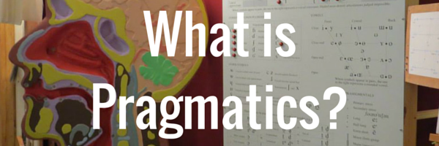
Lesson 2: Branches of linguistics
præɡˈmætɪks

Slide 11
Lesson 2: Branches of Linguistics
Diachronic Linguistics vs Synchronic Linguistics

Slide 12
Lesson 2: Branches of Linguistics
Theoretical Linguistics vs Applied Linguistics

Slide 13
Lesson 2: Branches of Linguistics
Comparative Linguistics vs Contrastive Linguistics

Slide 14
Lesson 2: Branches of Linguistics
MACROLINGUISTICS

Slide 15
Lesson 2: Branches of Linguistics

Slide 16
Lesson 2: Branches of linguistics

Slide 17
Lesson 2: Branches of Linguistics

Slide 18
Lesson 2: Branches of Linguistics
Biolinguistics
It explores the biological foundations of language.

Slide 19
Source: https://www.ethnologue.com
Visit this website and try to find some statistics about:
Living languages in the world
Deadline : December 23rd

