Slide 1
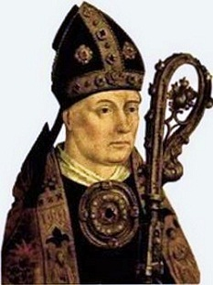
Médiéval Music
Medieval music marks the emergence of the Franco-Flemish school: beginning of vocal and instrumental forms including polyphony, courteous songs.
Philippe de Vitry, 1291/1361, French composer and prelate of the medieval period.

Slide 2
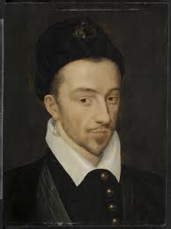
Music of the renaissance
The music of the Renaissance (1400/1600), marks the beginning of the Baroque period. Characteristics are the full sound, simple melody, beat alive, shape and proportion of simple and natural search
Clement Janequin is a composer, singer and French priest Canon (1485/1558) Famous throughout Europe for his songs polyphonic

Slide 3
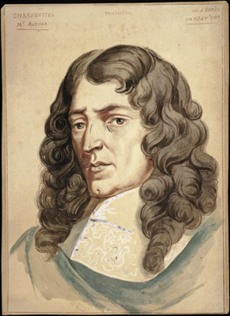
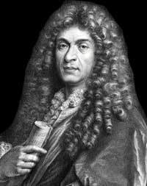
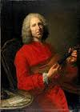
Baroque music
The word probably comes from the Portuguese baroque barroco which means pearl of irregular shape.
Baroque covers a large period in the history of music and opera. It extends from the early seventeenth century to about the middle of the eighteenth century.
Marc-Antoine Charpentier (1643/1704) is a French Baroque composer and singer.
Jean-Philippe Rameau (1683/1764) is a French composer and music theorist.
Jean-Baptise Lully
(1632/1687) is a French composer and violinist

Slide 4
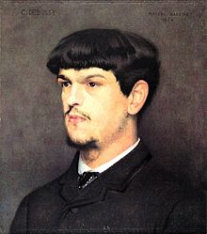
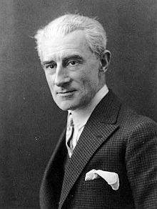
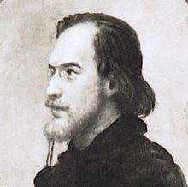
Classical Music
Some famous French composer
Claude Debussy (1862 – 1918)
Maurice Ravel (1875 – 1937)
Erik Satie (1866 – 1925)

Slide 5
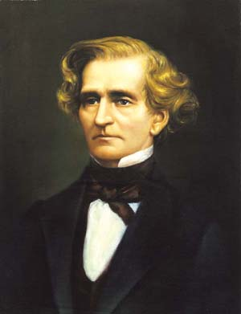
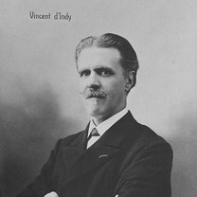
Romantic music
The expression romantic music refers to the period in the history of music from the early 18th century until early 20th century. Music, like painting, is influenced by romanticism in literacy.
Hector Berlioz (1803/1869) is a French composer, writer and critic. He is the author of the “Symphonie fantastique”.
Vincent d'Indy (1851/1931) French composer

Slide 6
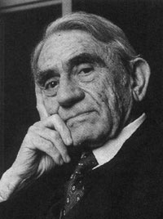
Contemporary music
Contemporary music refers to the various music emerged after the end of second World War and seeking ways, sometimes radically, outside the tonal system, established from1960
Pierre Schaeffer (1910/1995) was a French engineer, researcher, theorist, composer and writer. He is considered the father of concrete music and electroacoustic music.

Slide 7
The singers of the twentieth century and twenty-first century

Slide 8
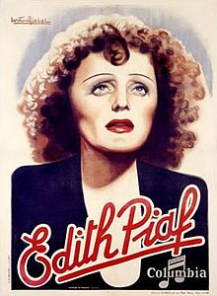
Music-hall
Edith piaf
Édith Piaf (1915/1963), is a French singer of music hall and commercial music. Fifty years after her death she is the most famous French performer in France and abroad.
Many success become classics, such as :
La Vie en rose
Non, je ne regrette rien
Hymn à l'amour
La Foule
Milord

Slide 9
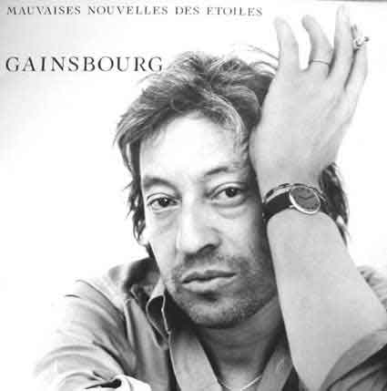
Jazz
Serge Gainsbourg
Serge Gainsbourg (1928/1991) is a painter, author, songwriter, pianist, writer, director, writer, actor and filmmaker French.
Le poinçonneur des Lilas
La javanaise
Je suis venu te dire que je m’en vais.

Slide 10
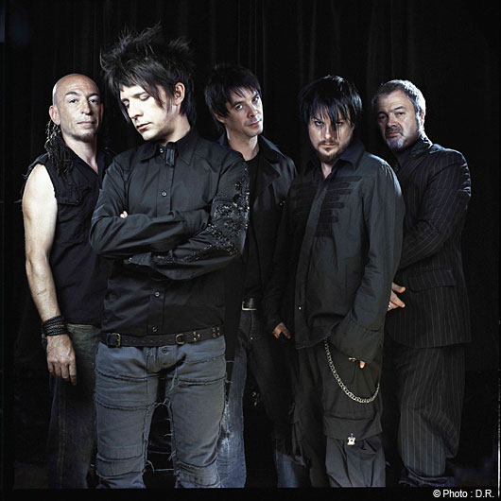
Rock
Indochine
Indochine is a French rock band. It has achieved significant success in the 1980s and in the 2000s and even today, in France but also abroad.
A famous song :
“L’aventurier”

Slide 11
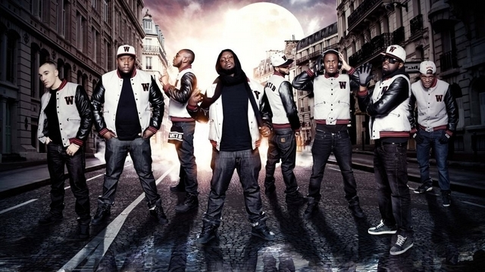
Rap
Sexion d’assaut
Sexion d'Assaut is a rap group formed in 2002, consisting of eight rappers from Paris:
first album: Black Mesrimes.

