Slide 1
Fashion in France from 1900.

Slide 2
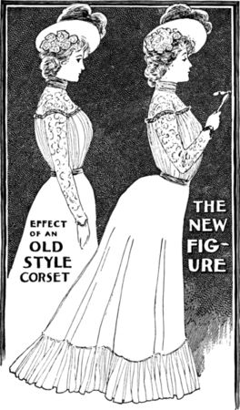
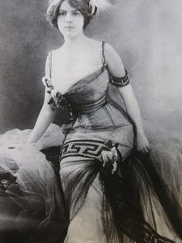
THE « BELLE EPOQUE »
Blouses have collars very high, rising until the chin day while evening dresses are very low-cut.
The top is arched and chest
is raised to flatten suckered.
1900 is the year of the invention of the corset says "straight-ahead" was supposed to be better for the abdomen

Slide 3
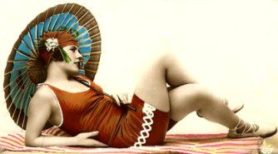
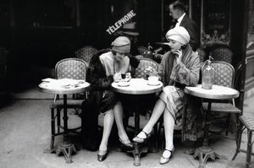
Les Années Folles (1920-1930)
At the end of World War I, French women began to emancipate…many widows and then forced to work. They thirst for freedom and above all want to be comfortable in their clothes.
Fashion of the 20s marked the golden age of fashion with French dress tailors like:
Jean Patou, Rochas, Lanvin, Chanel.

Slide 4
FASHION 80 YEARS : - The 80 years signent first sign «money and bragging »
- Eccentricites, even provocations.

Slide 5
Today : To avoid exclusion, young people must be integrated into the group. Young people prefer to wear clothes as "other"

Slide 6
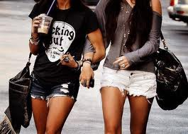
The Fashion victims of today Today, girls have no shame in being provocative in the way they dress. They have only 8 or 11 years but are already short t-shirt and tight and often a jewel in their navel pierced, a low-rise jeans, make up abundant and heels. A “personality" based solely on appearance.

Slide 7
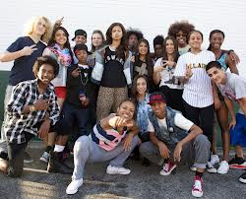
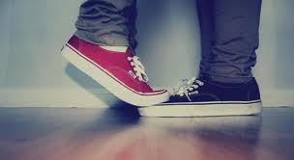
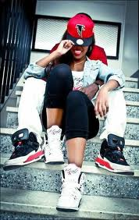
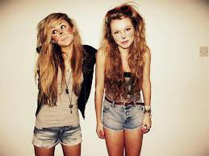
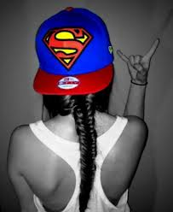
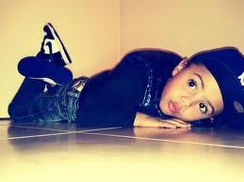
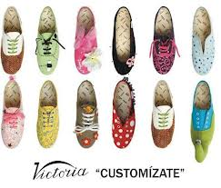
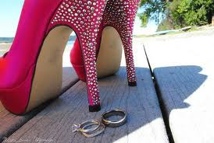
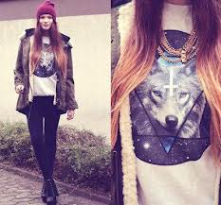
CE SONT NOUS LES JEUNES

