Slide 1
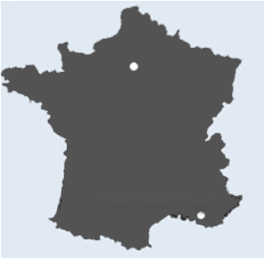
The biggest cities of France
The two biggest cities of France are Paris and Marseille because they exceed 500 000 people.
Paris
Marseille
PARIS : 12 161 542 people
MARSEILLE : 850 602 people

Slide 2
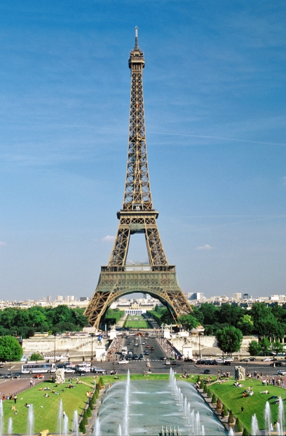
PARIS
Capital of France and Most populous city.
Crossed by the Seine.
Area : 105 .40 km²
The Eiffel Tower

Slide 3
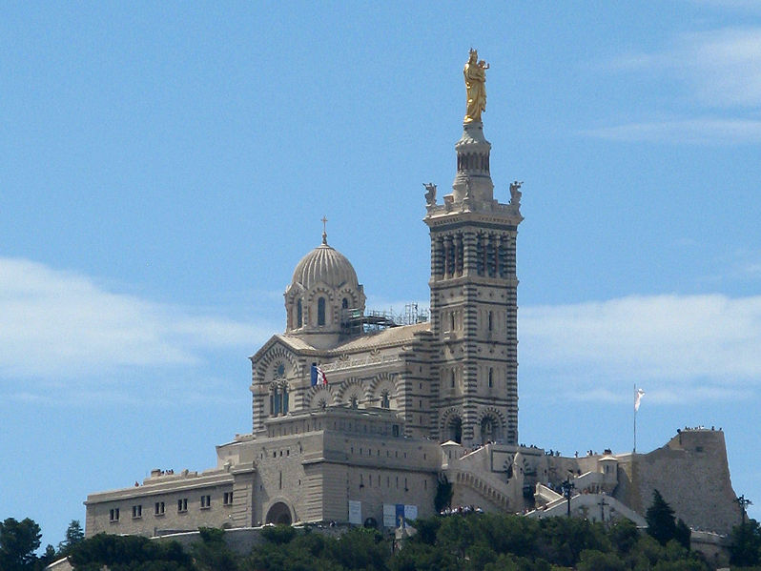
Marseille
It is the second most populous city.
Its area is 240.62 km²
It’s on the south-east seaside of France.
Notre-Dame de la Garde

Slide 4
QUESTIONS
What is the Historical Monument in the background of the slide in Paris
What is the Historical Monument in the background of the slide in Marseille ?

Slide 5
ANSWERS
On the slide about Paris, the historical monument is the Eiffel Tower.
On the one about Marseille, the historical monument is Notre-Dame de la Garde.

