Slide 1
Natural Disasters
A natural disaster is a natural event causing major upheavals and which can cause great human and material damages.

Slide 2
There are three sorts of disasters:
Earthquakes, Climatic and major astronomical disasters
In France the biggest disaster was a storm called Xynthia

Slide 3
Xynthia
Xynthia was a major meteorological depression which has hit several European countries between February and March 2010, causing a violent windstorm.

Slide 4
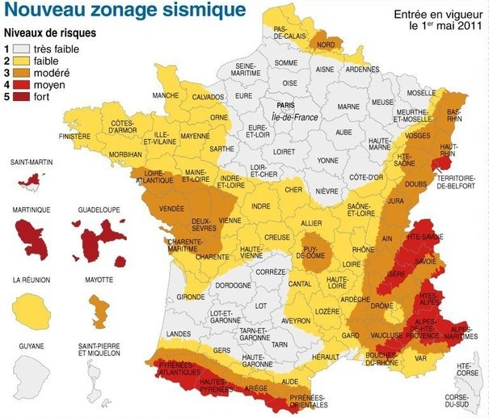

Slide 5
Questions :
When is the name of the last big storm in France ?
What are the main French seismic zones?

Slide 6
XYNTHIA
Pyrenees, Alpes et Alsace

