Slide 1
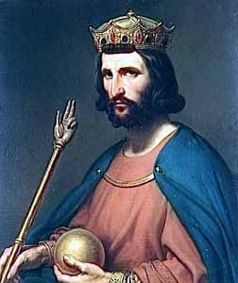
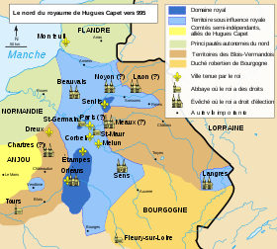
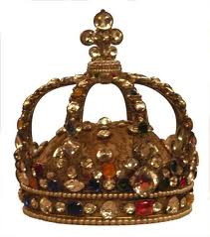
Hugues Capet
King of the French Capetian dynasty

Slide 2
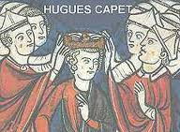
Biography
Hugh Capet was born around 941 in the Essonne near Paris and died in 996. He was King of the Franks from 987 to 996 and was the first king of the Capetian dynasty (who lasted 8 centuries) in competition with the Carolingian dynasty.

Slide 3
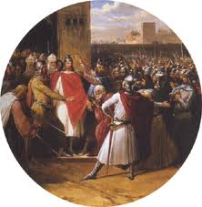
Access to power
Hugues Capet is the Son of Hugh the Great and Hedwig of Saxony. at birth He did not have much chance to be on the throne.

Slide 4
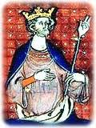
Creation of the Dynasty
He created a dynasty in consolidating his power and involving his son Robert the Pious.
He was crowned after the death of his father in 996.

Slide 5
QUESTION:
When was he crowned King of the Franks?
How long did the Capetian dynasty last?

Slide 6
Answer:
He was crowned after the death of his father in 996.
The Capetian dynasty lasted eight centuries.

