Slide 1
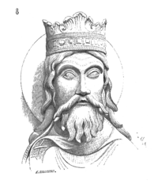
CLOVIS

Slide 2
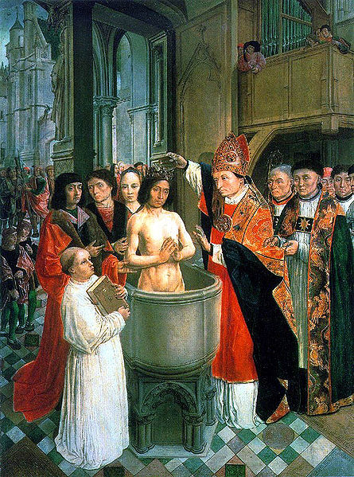
CLOVIS
The birth of Clovis
Clovis was born in 466, was batipsed
in 496 and died in Paris on 27 November 511 He was King of the Salian Franks.

Slide 3
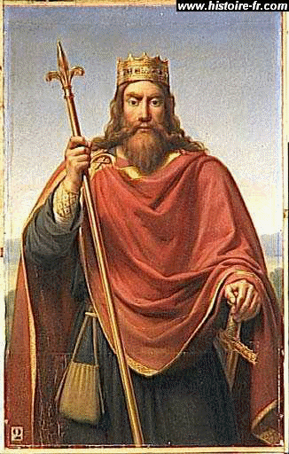
The reign of Clovis
He was king from 481 to 511 .
He made ​​alliances to expand his kingdom :
the conquest of the kingdom of Syagrius
with Ripuarians
- with the Romans

Slide 4
Questions
1 – When was Clovis baptized ? 2 - When was he king of all the Franks?

Slide 5
Answer
1 - His baptism was in 496 in Reims
2-He was the king of the Franks from 481 to 511

